Slide 1


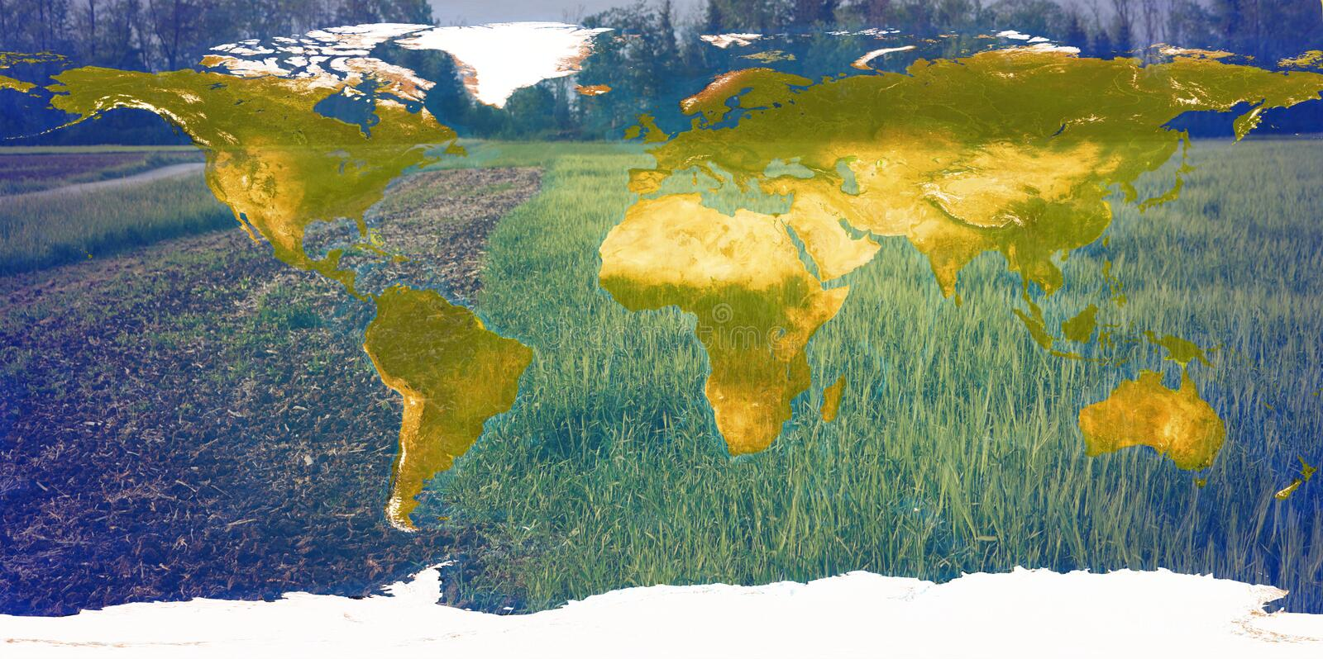
Landscape Diversity and Sustainable Agriculture Production
Michael B. Madin & Dr. Katherine S. Nelson
Background
The effect of landscape simplification on crop yields varies by soil type.
Both below ground (soil) and above ground (pollination) ecosystem services have a significant impact on production.
Results
Biodiversity on agriculture landscape provides ecosystem services considered as essential determinants of crop yields. While agriculture contributes to global ecosystem diversity, it has caused a significant loss of the earth's biodiversity through increased landscape simplification and intensification. There remains a need to examine how landscape simplification is associated with production of crops around the world after accounting for both above and below ground ecosystem services and the effects of management practices and weather.
Conceptual linkages of landscape and crop production
Soil
Nutrients
Water & Air
Weather
Time
Location
Knowledge
Management
Practices
Conventional
Organic
Crop Production
Landscape
Simplified
Diverse
Natural Pest
Enemy
Pollination
Service
Objective
Model Equation:
1. Production ~ Landscape*soil + weather + manag. practices
2. Production ~ Pollination + manag. practices + weather
This research seeks to examine the combined effects of above and below ground ecosystem services, together with climate variables, on crop yield across global farming regions.
Methods
Crop production varied by farm management practices, with a higher average production in organic farms compared to conventional farms.
Landscape simplification has a significant effects on crop production and varies by soil type.
More landscape simplification is associated with less production.
Fertile soil offset negative effects of landscape simplification on crop production.
Weather did not have a significant direct effects on crop production in our models, probably due to data limitations.
Increase pollination service was significantly associated with higher crop production.
Global database consisting of above ground ecosystem services, landscape composition, farm management practices at 1475 sampling sites published by Dainese et al. (2019).
Data on climate variabilities [WorldClim data]; and
Soil data [World Harmonized Soil Database], where percent organic carbon and texture class are used as proxy indicators of below ground ecosystem services.
Acknowledgments
We gratefully acknowledge the R3NRT program and NSF grant # 1828571.

